Slide 1
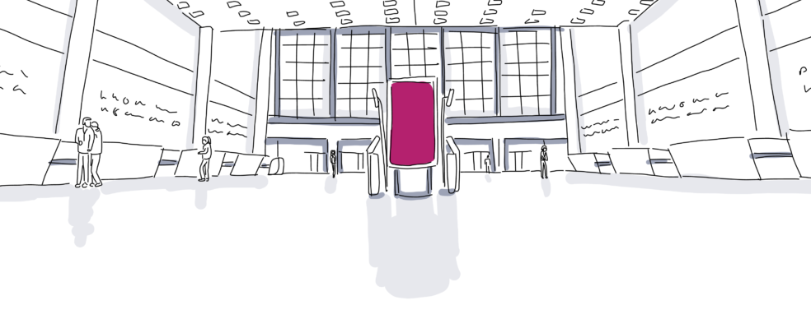
EVENT SOURCSING
By Brian Tran

Slide 2
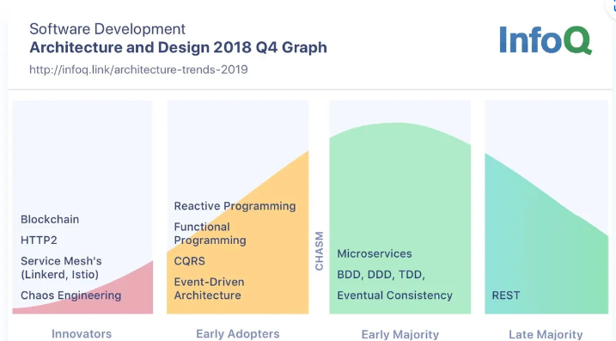
2018 Trend

Slide 3
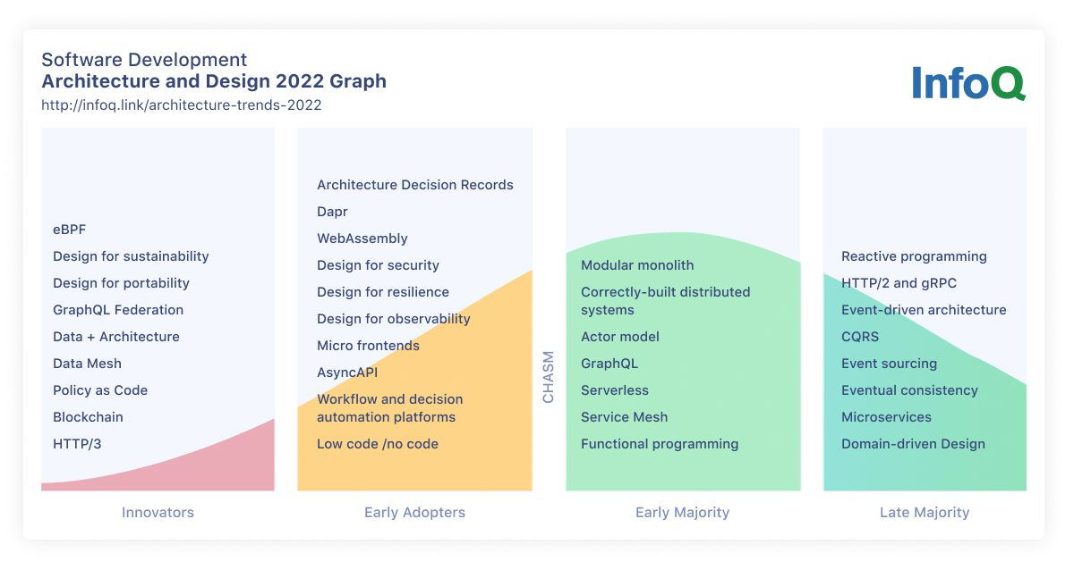
2022, now

Slide 4
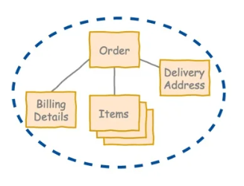
A couple of concepts from DDD
Aggregate
(Current) State of the Aggregate
Notes:
Aggregate is a pattern in Domain-Driven Design. A DDD aggregate is a cluster of domain objects that can be treated as a single unit.
An example may be an order and its line-items, these will be separate objects, but it's useful to treat the order (together with its line items) as a single aggregate.
An aggregate will have one of its component objects be the aggregate root. Any references from outside the aggregate should only go to the aggregate root. The root can thus ensure the integrity of the aggregate as a whole.
Aggregates are the basic element of transfer of data storage - you request to load or save whole aggregates. Transactions should not cross aggregate boundaries.
DDD Aggregates are sometimes confused with collection classes (lists, maps, etc).
DDD aggregates are domain concepts (order, clinic visit, playlist), while collections are generic. An aggregate will often contain mutliple collections, together with simple fields. The term "aggregate" is a common one, and is used in various different contexts (e.g. UML), in which case it does not refer to the same concept as a DDD aggregate.

Slide 5
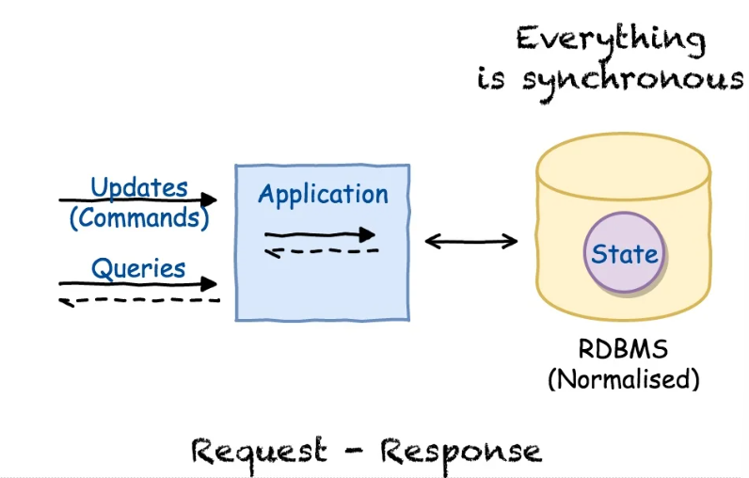
Once upon a time
Notes:
In traditional Web-based applications, a user input triggers a number of resource requests. Once the requests have been answered by the server, no further communication takes place until the user's next input. Such communication between client and server is known as synchronous communication.
The user clicks a UI control in a browser-based web application.
The browser converts the user's action into one or more HTTP requests and passes them along to the Web-application server.
The application server responds to the user's requests by returning the requested data to the user. At this point the application is updated and the synchronous communication loop is complete. A new synchronous communication loop will begin when the user next clicks a UI control in their browser.

Slide 6
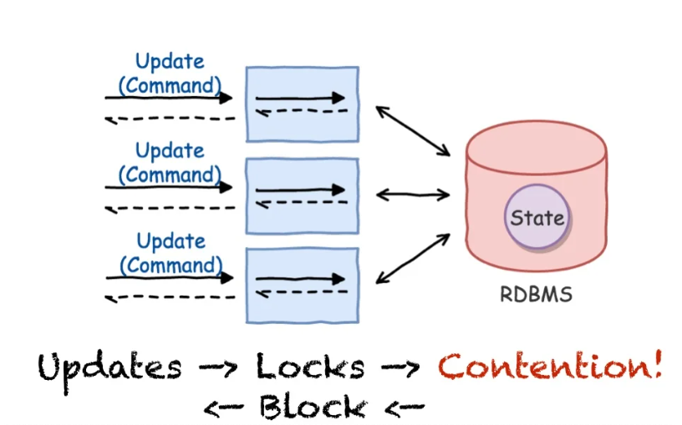
Scaling up …
Notes:
Uncontrolled multi-threading within an application can cause unpredictable end results. To achieve predictable results from an application, you need to synchronize execution of threads, and resolve data contention between threads; there are various methods you can use to achieve this.

Slide 7
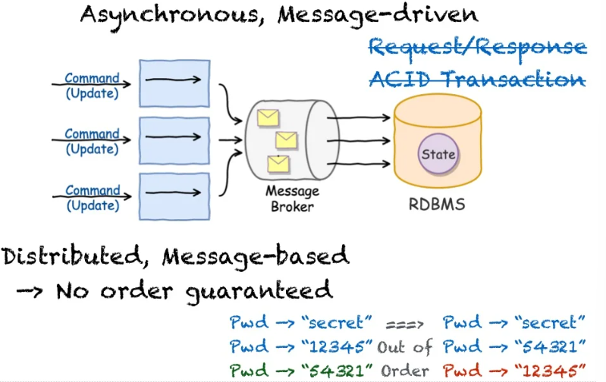
Let’s go Asynchronous
Notes:
Web 2.0 web-based applications address this issue by relying on asynchronous communication. Asynchronous applications deliver continuously updated application data to users.
This is achieved by separating client requests from application updates. Multiple asynchronous communications between client and server may occur simultaneously or in parallel with one another.
While asynchronous communication delivers tremendous value to users, it presents a serious challenge to software-testing tool vendors who have difficulty emulating it with traditional test scripts.

Slide 8
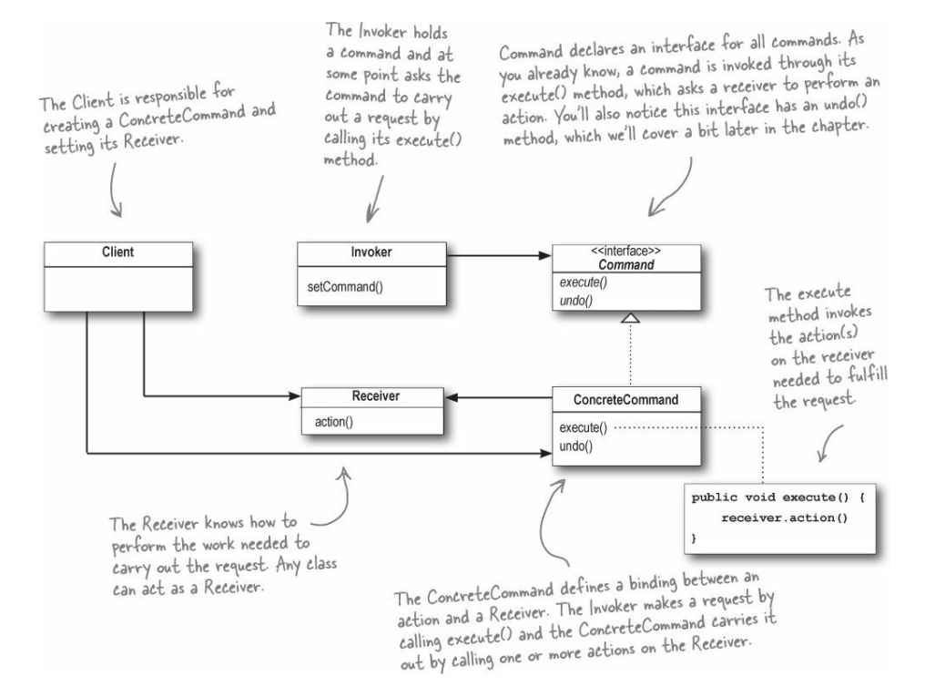
Command Pattern
Please tell me what do you know about this famous pattern !

Slide 9
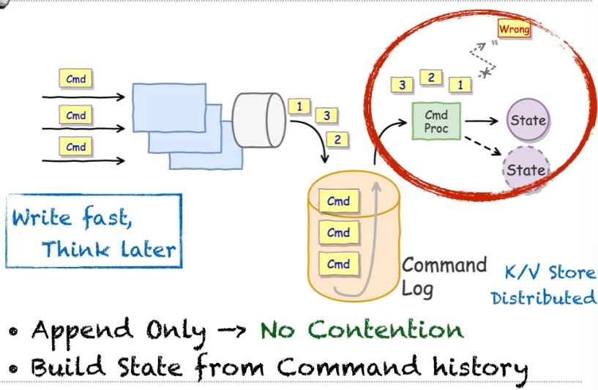
Command Sourcing

Slide 10
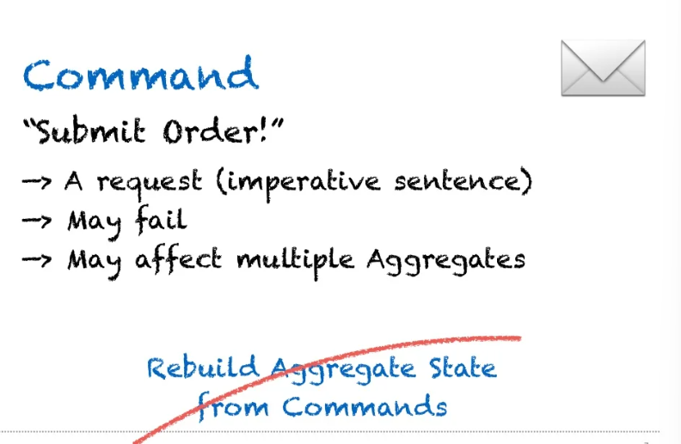
Command vs Events

Slide 11
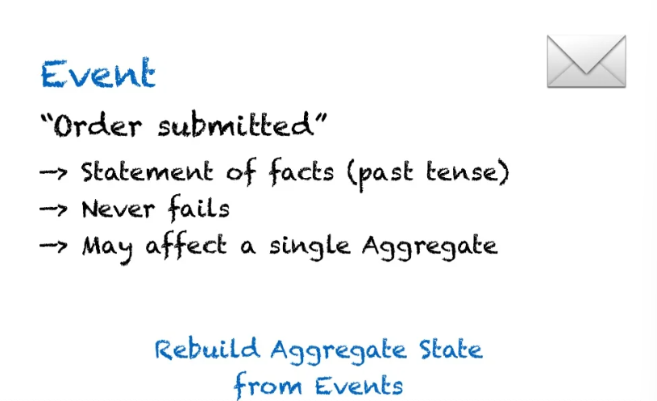
Command vs Events

Slide 12
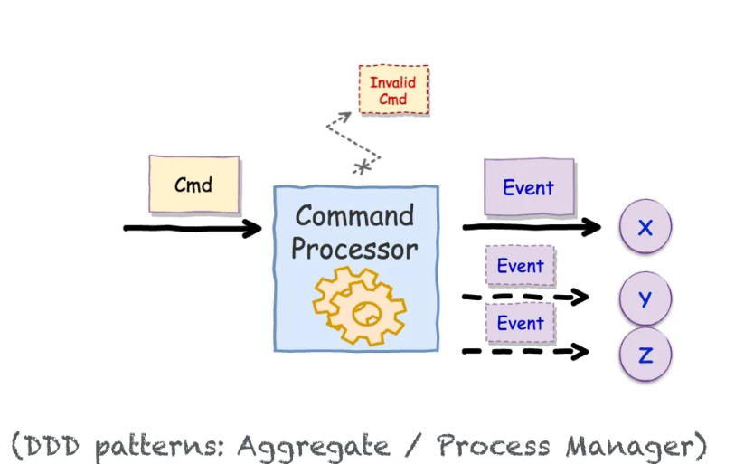
Commands to events

Slide 13
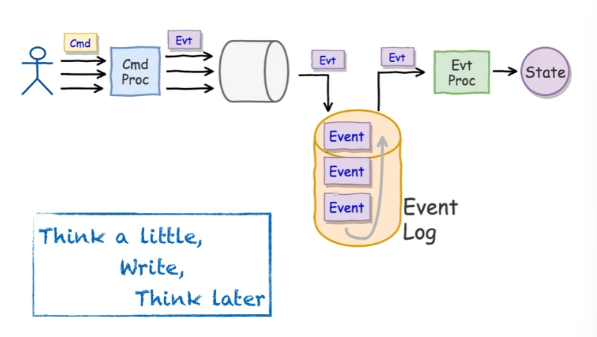
Command more than Event Sourcing
Notes:
A common problem with REDUX is SHOULD I put strategy to ACTION or REDUCER

Slide 14
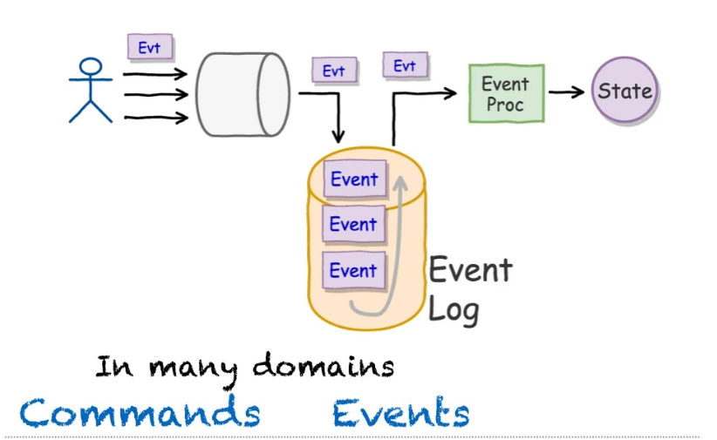
Event Sourcing

Slide 15
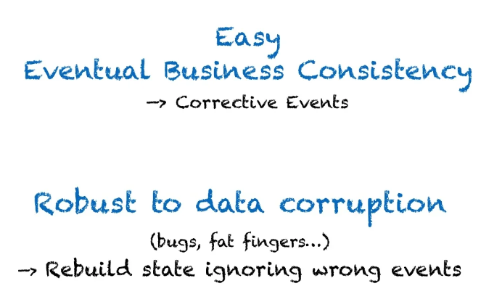
Additional benefits

Slide 16

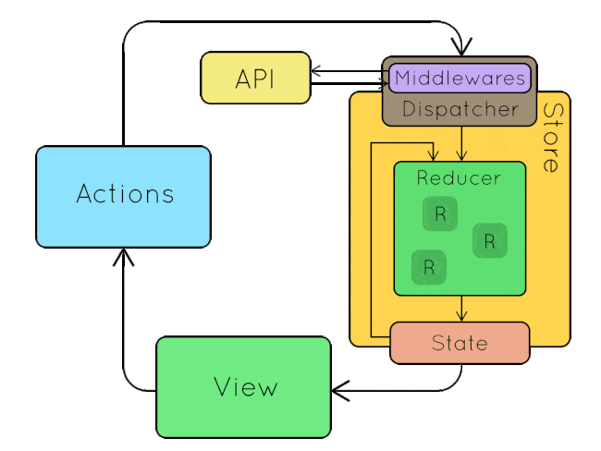
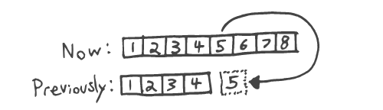
Time debugging
Dan Abramov (creator of Redux) has sung the praises of time-traveling debugging from a front-end perspective, and the same principle applies from a back-end one.
Notes:
Given that the event log is immutable, all changes to the application’s state must be driven by appending to the event log instead of changing it. This means that when our application behaves in a confusing way, we can simply start from the “beginning of time” and replay events one by one until we isolate the event that is triggering the confusing behavior. This is a powerful and incredibly simple tool for debugging our application.

Slide 17
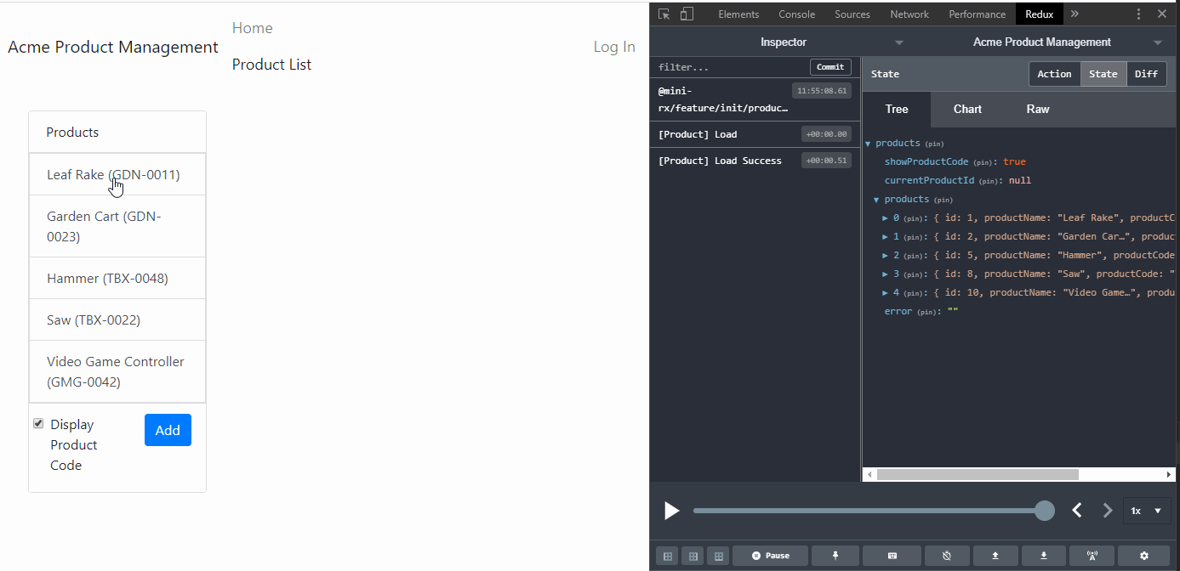
REDUX Dev-Tools Extension

Slide 18

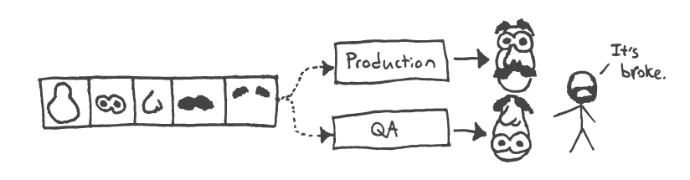
Technical Wealth
As Martin Fowler pointed out, instead of exclusively writing end-to-end tests we can explore a complementary approach: store and replay a sequence of events into the log, and then inspect the application’s state to ensure that it matches what we expect
Notes:
As Martin Fowler pointed out, instead of exclusively writing end-to-end tests we can explore a complementary approach: store and replay a sequence of events into the log, and then inspect the application’s state to ensure that it matches what we expect

Slide 19
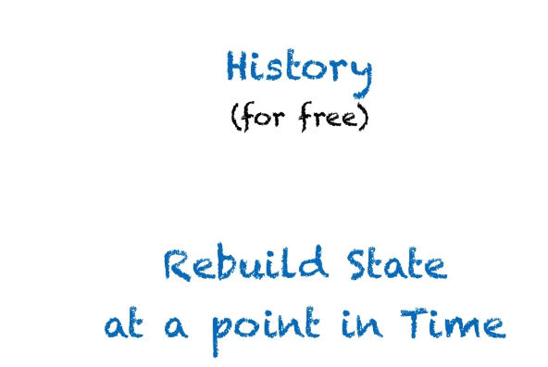
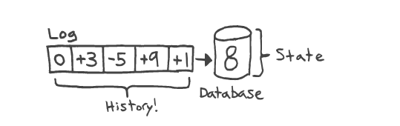
Additional benefits
Notes:
Historical Queries
A typical database can answer questions about your data as it exists right now, but it struggles to answer time-series queries about the historical context and evolution of your data.
For example, you can query your database to determine the number of user accounts that exist. But what if your business stakeholder wanted to know how many users create an account, delete it, and then change their mind and create it again? Your database typically will not capture this data, since it only stores the current state — it only stores the user account, and not the steps that were taken to create that account. Writing events to a log naturally makes these kinds of queries possible, because the historical data is never deleted. The ability to be able to answer any question that the business asks about the history of the application is incredibly valuable.
HOW > WHAT
Historical queries can ask, “How did we arrive at this state?”, instead of, “What does the current state look like?”

Slide 20
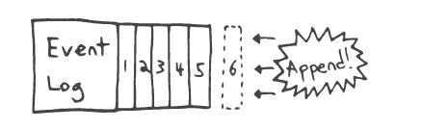
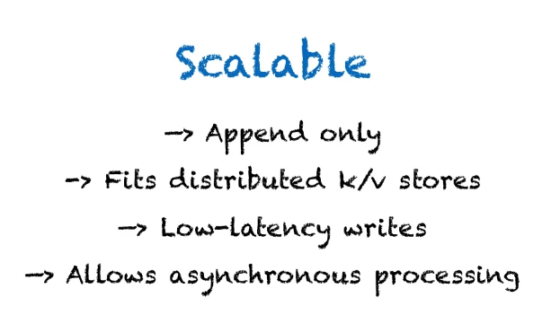
Additional benefits
Notes:
An event sourced architecture provides reasonable defaults for common scalability challenges that applications face as load increases, and after exhausting vertical scaling strategies. It isn’t a silver bullet (nothing is), but we can take comfort in the fact that we are probably not painting ourselves into a corner.
If writing to the event log is the bottleneck, we can split a single log into partitions spread over multiple servers, each responsible for handling writes to its fair share of the partitions. This is how Apache Kafka work
Immutable Data
Modeling your data as an immutable, append-only log of events greatly simplifies reasoning about how the application works. It is harder to get yourself into a confusing situation by accidentally mutating state. This is easier to understand when we consider the utility of time-traveling debugging.

Slide 21
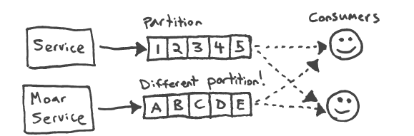
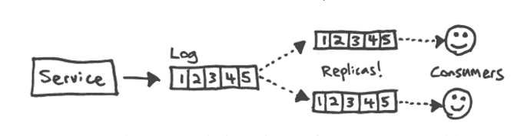
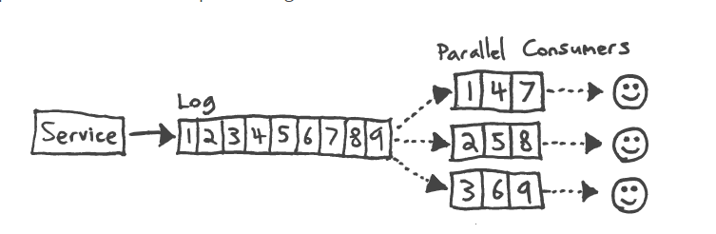
Bottle neck!! YES we can deal with that
WRITE
READING
Need more reader
Notes:
If writing to the event log is the bottleneck, we can split a single log into partitions spread over multiple servers, each responsible for handling writes to its fair share of the partitions. This is how Apache Kafka work
If reading from the event log is the bottleneck, we can introduce log replication and have consumers read from the replicas.
If consumers cannot keep up with the volume of events, we can add more consumers and parallelize the work of processing the events.

Slide 22
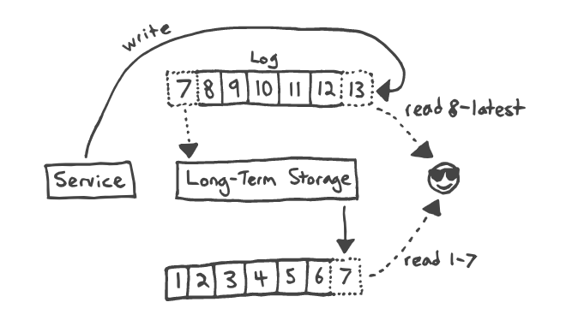
Bottle neck!! YES we can deal with that
Notes:
If we run out of disk space to store the log, we can explore options for long-term storage. We could write a service to read older log messages and push them into a some kind of data warehouse. Consumers which only need to keep up with processing new-ish messages read directly from the primary log. Consumers which wish to rebuild their local state by processing all log messages from the beginning of time may do so by reading from the data warehouse until they reach the most recent warehoused message, and then switch to reading from the primary log.
Example: I have 1 million data to stores from Haravan.
Tables structure is differents from Haravan and Prestashop. I wanna migrate data from old system to new.

Slide 23
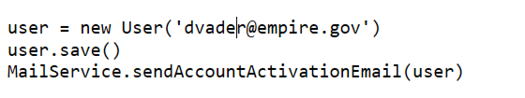
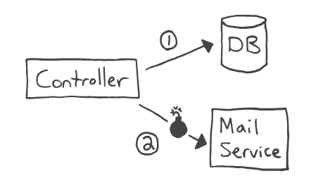
Fault tolerance and resiliency
In a traditional monolithic system, the controller which handles this logic might look something like this pseudocode
The above logic will work 99% of the time. But every now and then the MailService will go offline. The new account will be created but the user will not receive their activation email. The user cannot activate their account
Notes:
This is my favorite feature of a log-oriented architecture, and the one that attracted me to event sourcing.
Often, one portion of an application will need to react to a change in a different subsystem. For example, when a user account is created, we might want to send an account activation email to that user.
In a traditional monolithic system, the controller which handles this logic might look something like this pseudocode.
Remember: we can often substitute rapid recovery for high availability. Instead of investing significant sums to achieve high availability, we can Pareto-optimize by investing a smaller amount into rapid recovery. For example, instead of buying the world’s most reliable hard drive, we could simply make frequent backups. Our system can go down frequently, but the user will never notice as long as we can recover in a reasonable amount of time. As Gary Bernhardt astutely points out, TCP is so good at this that we take it for granted!
This is a tricky situation to recover from, and an example of the problem of dual writes. It would be much better if we could build an application which simply pauses when a subsystem goes down, and resumes from where it left off when that subsystem comes back online. This would provide tremendous peace of mind, save countless users from headache, and prevent us from wasting many days recovering from, debugging, and prematurely optimizing the availability problems of our MailService.

Slide 24
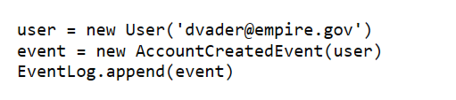
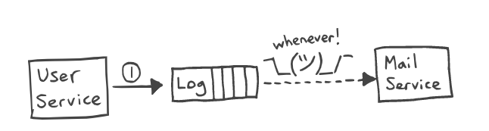
Defense in depth strategies
The first layer of defense is designing for availability, and the second layer is designing for recovery.
The second layer is designing for recovery.
Notes:
The email service would be monitoring the log for new account creation events and would send emails in response to those events.
If the email service were to go offline, it could simply pick up from where it left off. In fact, the email service could go offline for days,
and catch up on unsent emails when it comes back online. It could also contain a memory leak which causes the system to crash every hour,
but as long as the email service restarts automatically, your users will not likely perceive a service interruption.

Slide 25

End normalization debate
Notes:
Database normalization is a database schema design technique, by which an existing schema is modified to minimize redundancy and dependency of data.
Normalization split a large table into smaller tables and define relationships between them to increases the clarity in organizing data.
Database Normalization (w3schools.in)
There is a tension between read- and write-optimized schemas.
At a certain point, in order to boost read performance, we are tempted to deformalize our database.
We might also attempt to cache query results from the normalized database, usually employing some kind of error-prone, dual write strategy.
A log-oriented system breaks the tension by deriving one or more read models from the log.
We accept from the outset that one model cannot be great at everything. The log is write-optimized, and the derived read models can be denormalized to suit their specific usage pattern.

Slide 26

Prevent Super user attack

Slide 27
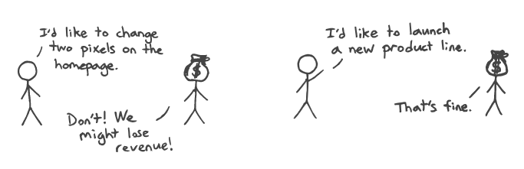
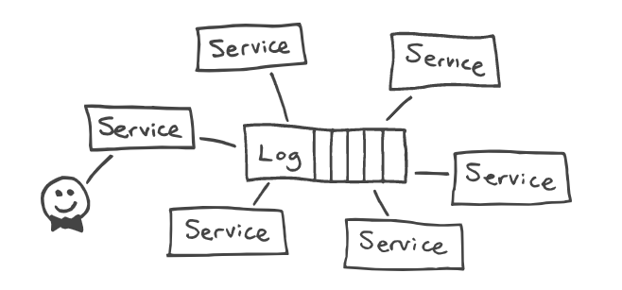
Better business Agility
Notes:
Kleppmann sees agility enhancing benefits in this approach to building software, and I think he’s on to something.
Monolithic, stateful systems are optimized for consistency, not for change.
At a certain point it becomes difficult to make changes, because those changes must render the system consistent when completed.
Within a large system, that is no small feat! The result is that the rate of change decreases, because it becomes a huge pain to run even a small experiment.
The ability to connect new consumers to the log stream opens up the possibility of bypassing existing systems to build one-off experiments.
There is no need to run a migration to modify a database schema — simply deploy a new service with a different database,
and store the additional data there for the duration of the experiment.
The same goes for new read models, which can provide denormalized views for experimental new queries.
Have you ever noticed that changing an existing system tends to trigger a The act of wasting time on trivial details while important matters are inadequately attended
Adding a new system, in my experience, does not produce the same strong political reaction.
My hunch is that this is because changing an existing system might break something, which a college consider incredibly valuable, even sacrosanct.
So by architecting our application to allow for the easy introduction of new subsystems, it seem reasonable to expect that we could actually reduce the amount of political debate associated with the running of experiments.

Slide 28
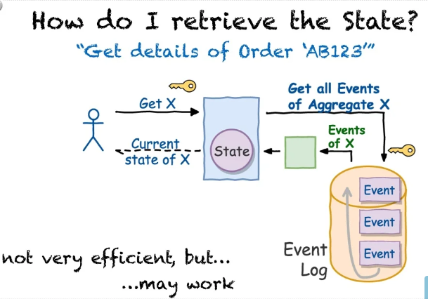
Retrieving the State

Slide 29
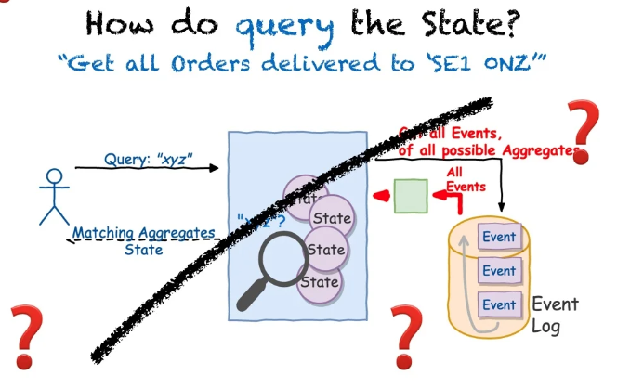
Querying (searching) the state

Slide 30
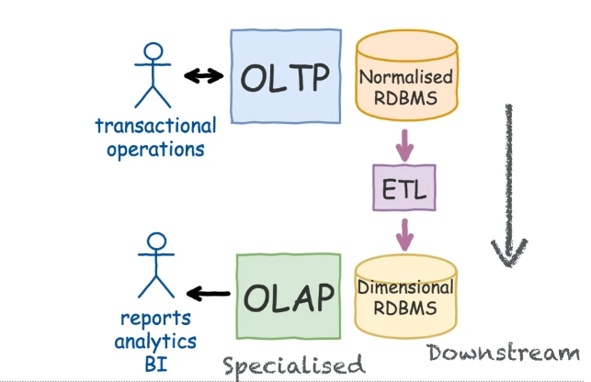
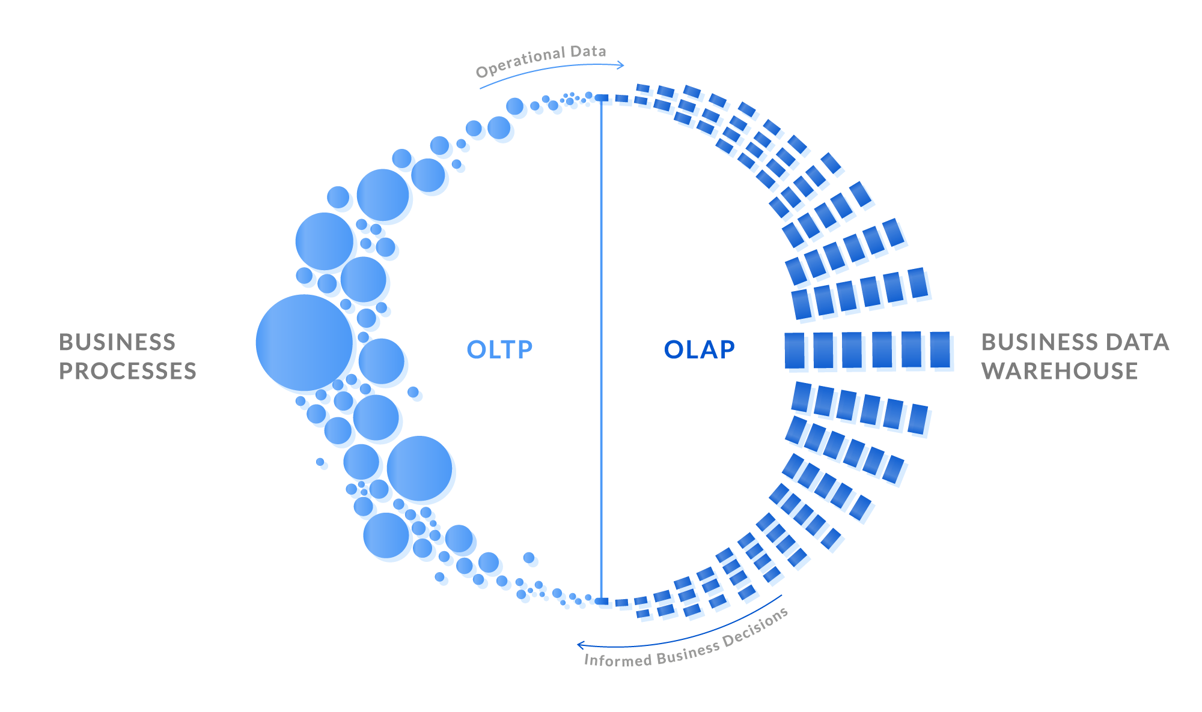
Old school way
Notes:
OLTP (On-line Transaction Processing) is characterized by a large number of short on-line transactions (INSERT, UPDATE, DELETE). The main emphasis for OLTP systems is put on very fast query processing, maintaining data integrity in multi-access environments and an effectiveness measured by number of transactions per second. In OLTP database there is detailed and current data, and schema used to store transactional databases is the entity model (usually 3NF).
– OLAP (On-line Analytical Processing) is characterized by relatively low volume of transactions. Queries are often very complex and involve aggregations. For OLAP systems a response time is an effectiveness measure. OLAP applications are widely used by Data Mining techniques. In OLAP database there is aggregated, historical data, stored in multi-dimensional schemas (usually star schema)
ETL, which stands for extract, transform, and load, is the process data engineers use to extract data from different sources, transform the data into a usable and trusted resource, and load that data into the systems end-users can access and use downstream to solve business problems.

Slide 31
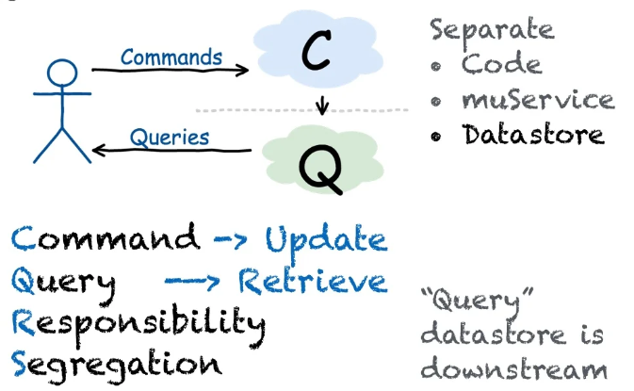
CQRS

Slide 32
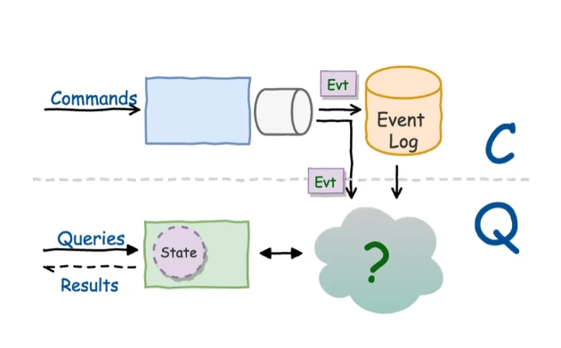
CQRS and event sourcing

Slide 33
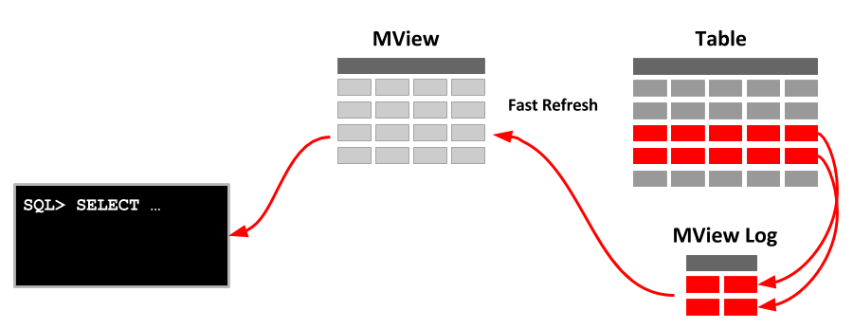
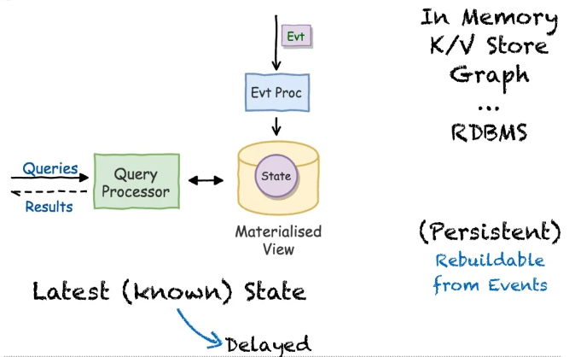
Materialized Views of current state
As Backend engineer who have many year working with SQL. What is Matview @Cris?
Notes:
In computing, a materialized view is a database object that contains the results of a query. For example, it may be a local copy of data located remotely, or may be a subset of the rows and/or columns of a table or join result, or may be a summary using an aggregate function.
Summarize Materialized Views
Good Points
lấy dữ liệu nhanh hơn
Bắt được điểm chung của joins và filters
Đẩy nhanh quá trình xử lý từ ruby sang BD
Cho phép filtering nhanh và trực tiếp các complex associations or calculation .fields
Pain Points
Chúng ta cần phải viết sql để xử dụng chúng
Chúng ta sử dụng nhiều ram và bộ nhớ hơn
MatView chỉ có trên Postgres 9.3 trở về sau
Postgres 9.4 mới có refresh concurrently
Không có được live data

Slide 34
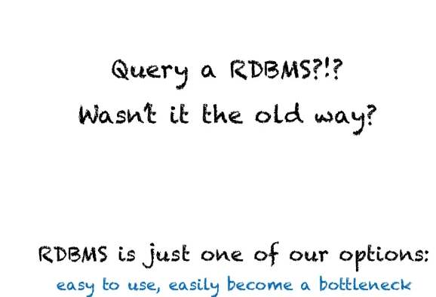


Slide 35
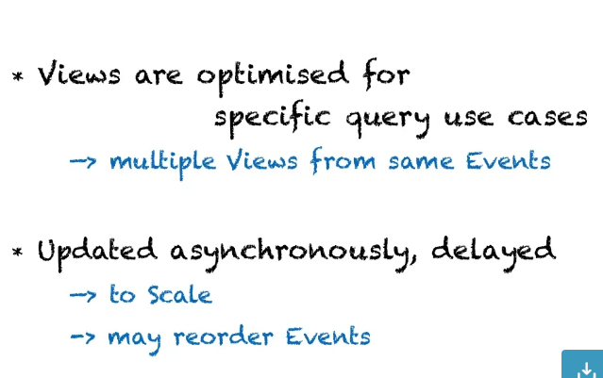

Slide 36
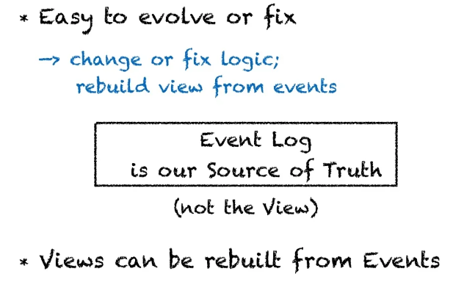

Slide 37
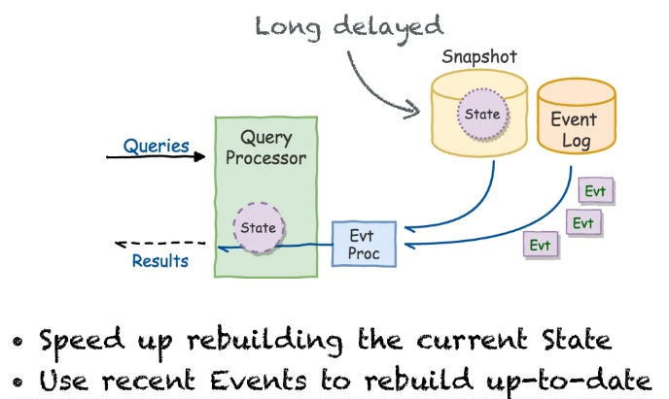
Hybrid solutions: e.g snapshots

Slide 38
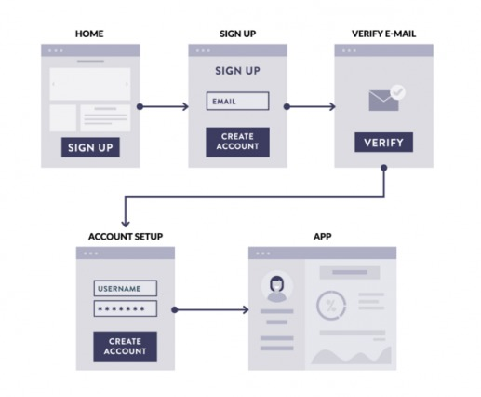
Let’s do whiteboard system design
We will have 2 teams, design and debate what they designed:
Please design it in monolith (5’)
Migrate it to microservice (10’)
Your decisions is most important in this game let debate (15’)
Note: (10) How to Whiteboard for System Design Interviews | Tips & Tricks - YouTube
Notes:
00:39 - Clarify the requirements
01:55- Define your data model
02:28 - Take notes on decisions
03:11 - Diagram your design
04:21 - Keep things legible

Slide 39
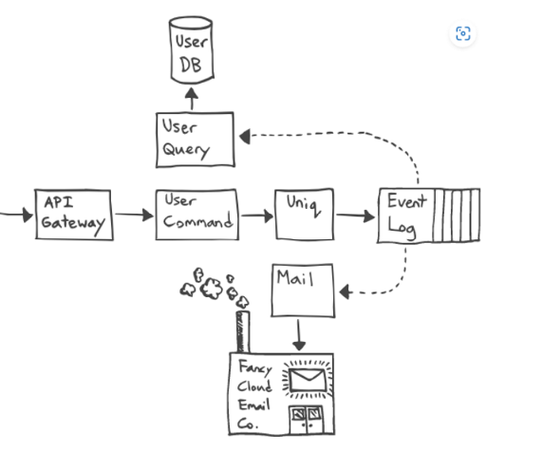
Signup for An Account
Failure Modes
Validation
Maybe You Don’t Need Immediate Consistency
Lock
Temporal Anomalies
Fencing Tokens
Filtering Duplicates
Uniq Service
Relational Database Envy
The Read Model
Sending Mail
Dependency Woes

Slide 40

THANKS, YOU

